Slide 1


ParkSafe
Your Quick Parking Solution!

Slide 2
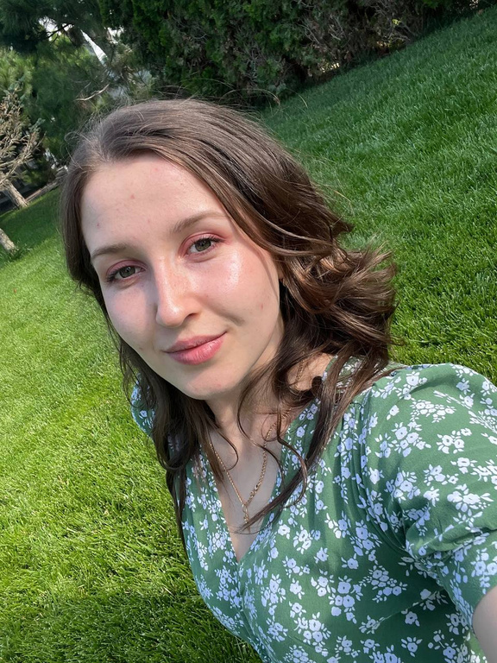
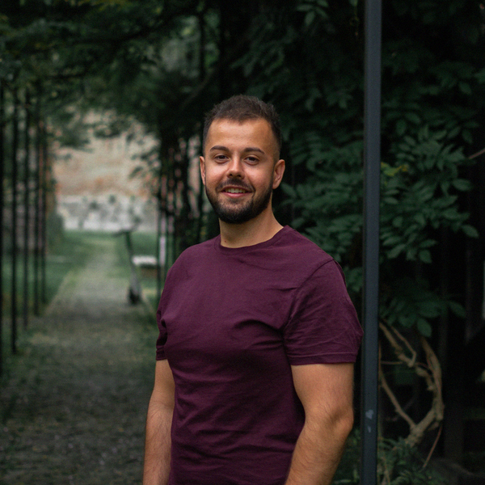


OUR TEAM
Pegza Ariadna
Wolff Andreas
Pințoiu Fernando
Hopîrtean Cosmin

Slide 3
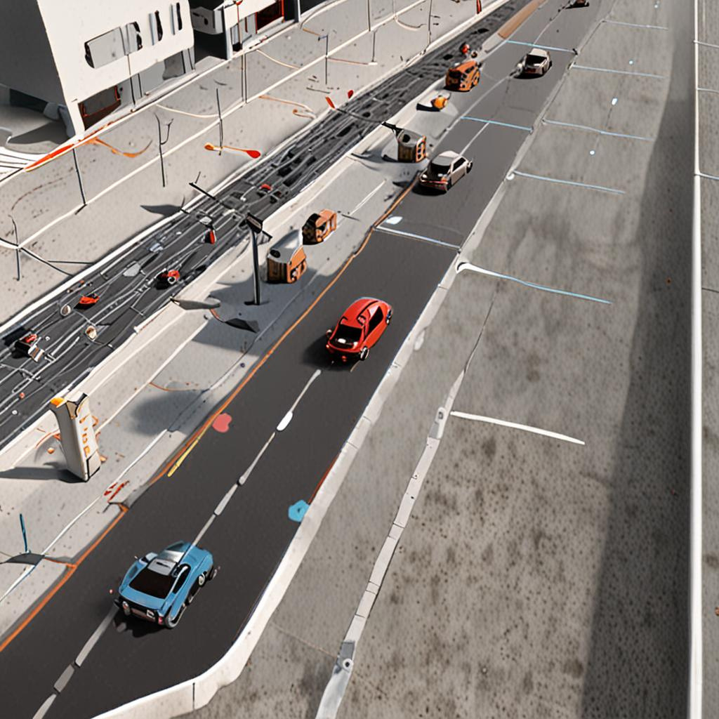
Problem
Finding a parking space in crowded cities can be a major challenge, time consuming and an environmental hazard.

Slide 4

Solution
Development of a mobile app that uses sensors placed in parking spaces to identify and provide directions to free parking spaces.

Slide 5
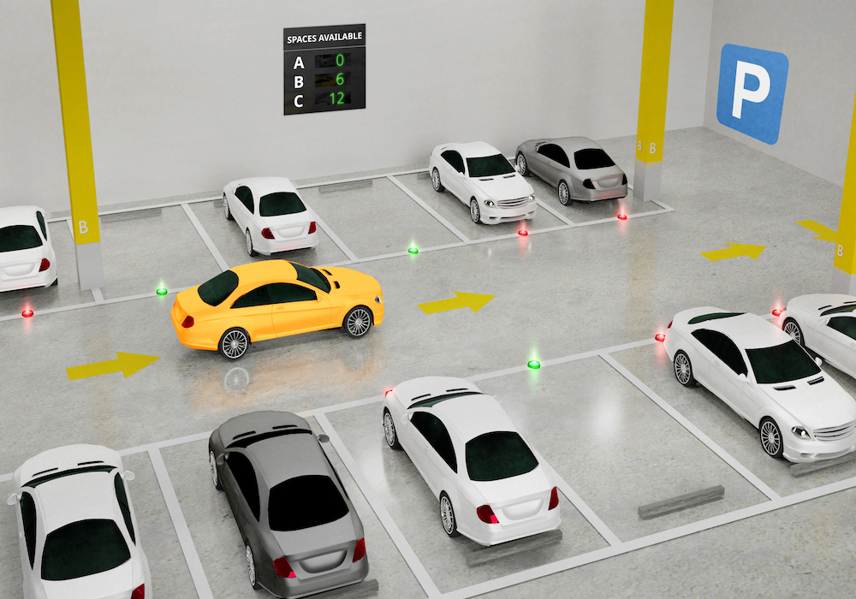
Origins
The idea for the parking app was born out of the need to solve the parking difficulties faced by students who do not have classes in the morning and therefore do not find available spaces when they arrive at the university. The app allows students to check the availability of parking spaces on campus remotely, thus reducing the time wasted searching for a free parking space upon arrival.

Slide 6

Application features
Detection of the free spaces
Using sensors to monitor real-time availability
of parking spaces
Real-time status updates of parking
spaces in the app.

Slide 7
START
APPLICATION AND SENSOR INITIALIZATION
PARKING SPACE APPEARS
Yes
No
PARKING SPACE DISAPPEARS
FREE PARKING SPACE?
DATA UPDATE
SYNCHRONIZES DATA
WITH THE APP
STOP

Slide 8
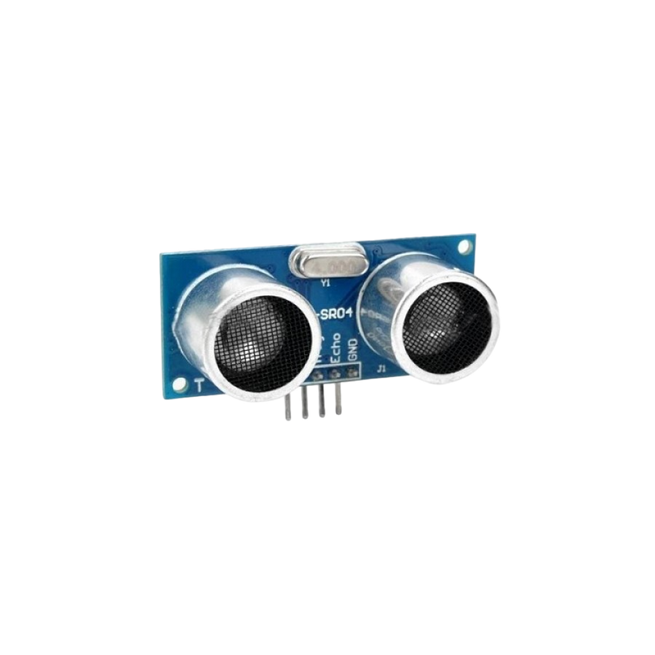
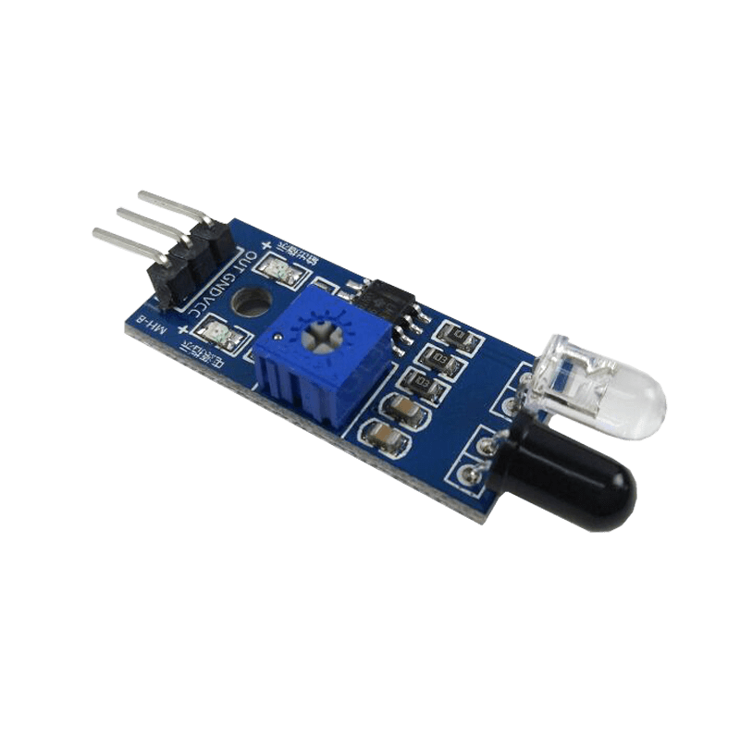
Ideal sensor placement
IN FRONT
Quickly detects vehicles entering the parking space, provides accurate monitoring of parking space occupancy.
ON THE SIDE
Detects if a vehicle is completely occupying the parking space or if there are parts of the vehicle that exceed the limits of the parking space, giving a clear picture of availability, essential for parallel parking
UNDERNEATH
Very accurately detects occupancy by directly measuring the presence of a vehicle above the sensor, being protected from environmental elements these sensors have a longer lifetime (reducing maintenance costs), do not affect the aesthetics of the parking lot

Slide 9
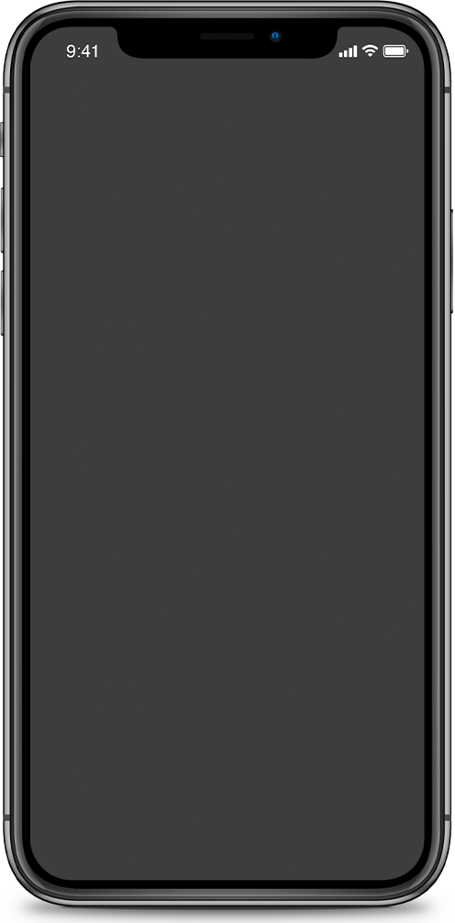
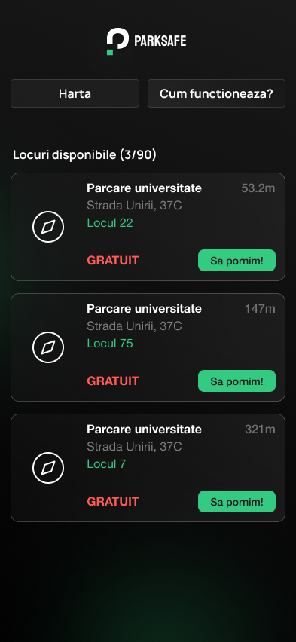
Visual Representation of Information
Parking cards
Each parking space has a virtual card displaying key information such as distance, price
(if applicable) and estimated
time to occupancy

Slide 10



Advantages of our app
Reducing search time
Improving traffic efficiency
Environmental benefits
Finding a parking space quickly reduces search time and associated stress.
Optimize traffic flow by reducing the number of vehicles looking for parking.
Cut CO2 emissions by reducing time spent in traffic

Slide 11

App monetization
Reservation System:
Free Wait Time: 5 minutes.
Paid Wait Time: Additional 5 minutes(50 bani/min.)
Total Wait Time: 10 minutes.
Offer premium features such as extended reservation times

Slide 12

Parking space security
Arrival Confirmation:
When you arrive at your parking spot, a push notification prompts you to confirm your occupancy via the app.
Incorrect Occupancy Alert:
If you receive the notification and are not at the parking spot, the sensor emits a beep to alert the unauthorized occupant to vacate the space.
This system ensures accurate tracking and minimizes unauthorized use.

Slide 13
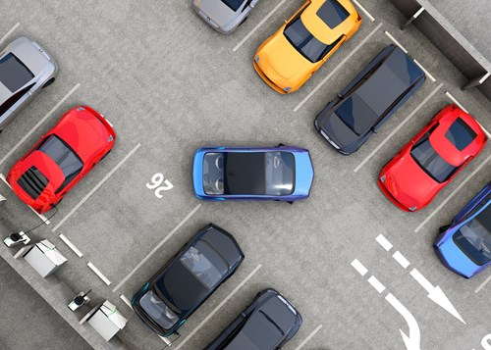
Examples of implementation
500 PARKING SPOTS FAVORABLY PLACED
IMPLEMENTATION COST: ~ 12.000 EUR
ANNUAL MAINTANANCE COST: ~1.000 EUR
100 PARKING SPOTS PLACED LINEARLY
IMPLEMENTATION COST: ~ 8.000 EUR
ANNUAL MAINTANANCE COST: ~500 EUR

Slide 14
Thank you :)

